Slide 1
MAKING DISASTER DISPLACEMENT VISIBLE IN BRAZIL
Photo: João Quesado. Sertão, Pernambuco, Brazil
A review of the national disaster data collection and information system
Authors: Andrea Zamur, Diogo A. Serraglio, Erika P. Ramos, Fernanda S. Cavedon-Capdeville, Luiza Pallone

Slide 2
Agenda
Background of disaster data collection in Brazil
Normative and structural context
The Integrated System of Information on Disasters – S2ID
Identifying displacement - categories and terminology
Existing gaps and inconsistencies
Opportunities for improvement and ways forward

Slide 3
Background of disaster data collection in brazil
2011
Heavy rainfall and landslides in the ‘Serrana’ region of Rio de Janeiro
Most severe environmental disaster recorded in Brazil until then
Made evident the necessity to strengthen prevention and preparedness practices nationwide
2012
Several improvements in the government’s approach to disasters
National Policy on Protection and Civil Defense (PNPDEC) – Law n. 12,608/2012
Creation of the National Centre for Monitoring and Early Warning of Natural Disasters (CEMADEN)
Creation of the Integrated System of Information on Disasters (S2ID)

Slide 4
Normative and structural context
National Policy on Protection and Civil Defense (PNPDEC) – Law n. 12,608/2012
Normative Instruction N. 02 of 20 December 2016
Form for Information about the Disaster (FIDE)
Systemic approach for disaster risk management, increasing transparency and coordination
Criteria and procedures to be followed by all levels of the National System of Protection and Civil Defense in order to decree a situation of emergency or a state of public calamity, which determine the transfer of federal funds
Municipalities and states must use it to compile all initial information about the disaster, which is sent to the federal level for approval and then included in the S2ID
Use of the Integrated System of Information on Disasters (S2ID) becomes mandatory

Slide 5
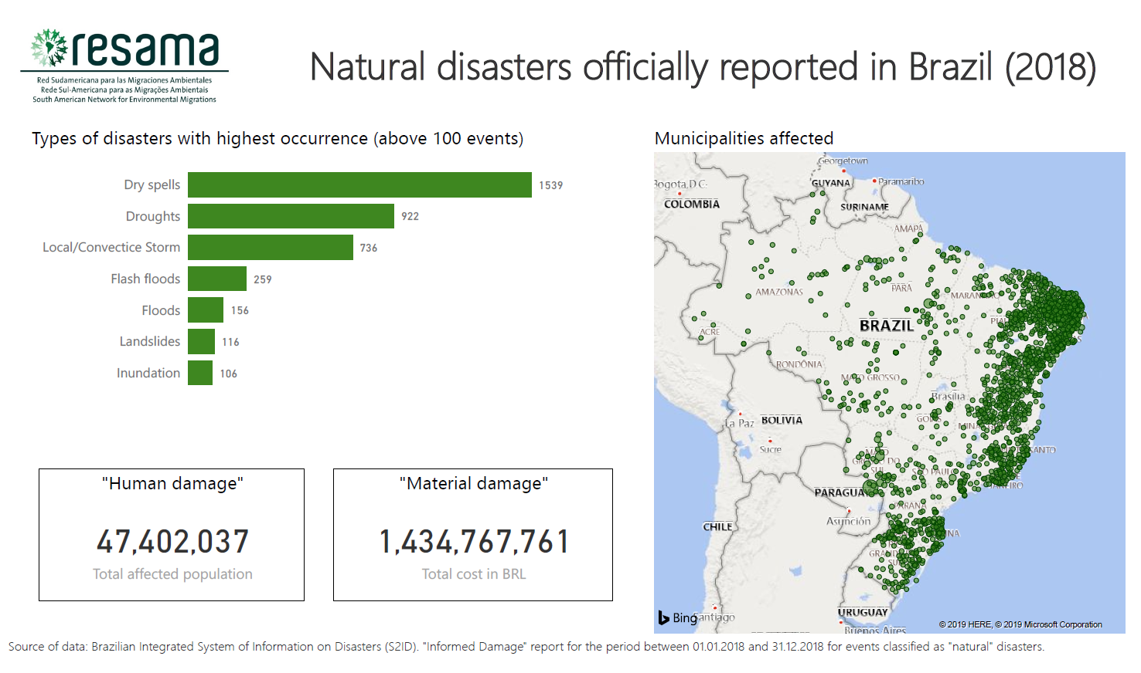

Slide 6
Identifying displacement
The Form for Information about the Disaster (FIDE) has a section dedicated to “Human Damage” which includes 7 categories:
Original term | Translation | Definition
Mortos | Dead | Deceased people
Feridos | Injured | Injured people that may need hospitalization or not
Enfermos | Sick | People that developed diseases
Desalojados | Dislodged | People whose houses have been damaged or destroyed, but do not necessarily need temporary shelter
Desabrigados | Unhoused/Unsheltered | People that have been dislodged and need temporary shelter
Desaparecido | Missing | People that have not been localized or whose location is unknown, in the circumstances of a disaster
Outros | Others | People that have been victimized in a way that differs from the ones previously mentioned. In this case, the system requires a description.

Slide 7
GAPS And inconsistencies
Legal framework does not adopt the concept of displacement, with exception to brief mentions about of evacuation and planned relocation
Data collection system does not include a category that reflects the situation of displacement. The categories of “dislodged” and “unhoused/unsheltered” are related to housing damages and the need for temporary shelter
Uncertainty regarding the total number of events: data collection is done by local authorities in the context of the emergency and is mandatory to request federal funds – different local authorities can report the same event

Slide 8
GAPS And inconsistencies
Absence of monitoring procedures – number of “dislodged” and “unhoused/unsheltered” is not updated in the long term
Absence of disaggregated data
Disparities in the quality of the data collected – events are frequently reported in a poorly manner, especially slow-onset disasters (e.g. “other affected”)
Reports with quantitative data collected (e.g. description for “other affected”) not available with the same frequency as the dataset of Informed Damage
Official deadline for reporting: 15 days for sudden-onset and 20 days for slow-onset – challenges to capture slow-onset disasters

Slide 9
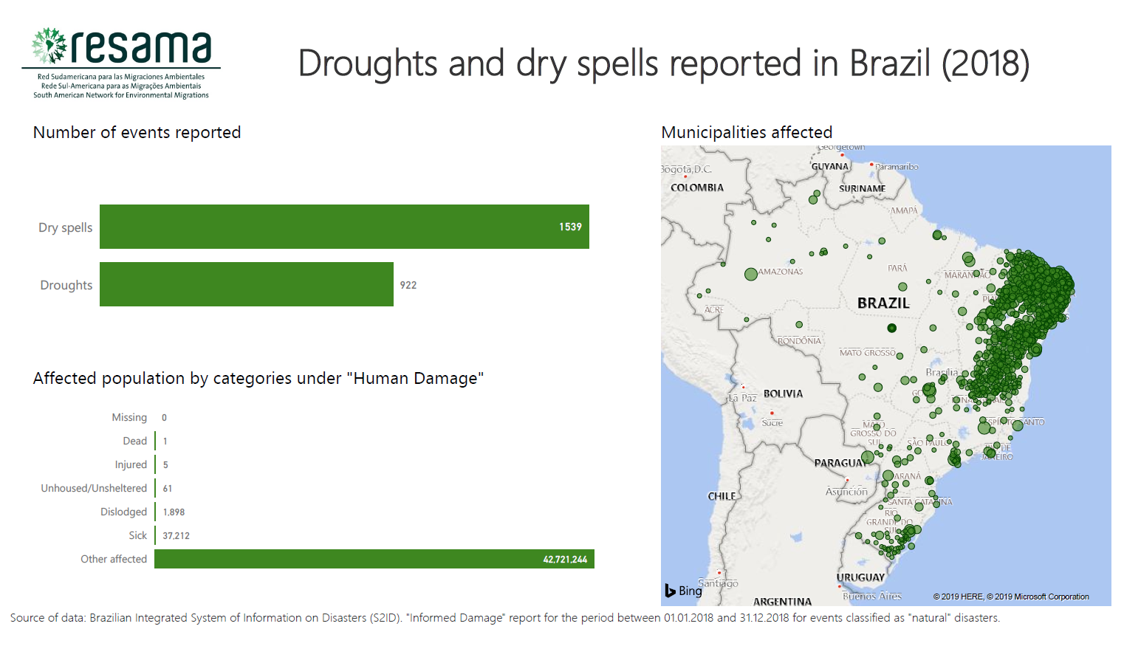

Slide 10
Opportunities for improvement
Revise the legal framework and policies related to disasters in order to include provisions related to displacement, in alignment with international guidelines;
Revise data collection forms to incorporate appropriate terms and categories that reflect situations of displacement;
Invest in capacity building with local authorities regarding methodology, criteria, concepts and terminology;
Develop protocols to harmonise data collection and the diffusion of information, in order to enable comparative analysis and reliable statistics;
Invest in the development of methodologies that consider the different timescale and impacts of slow-onset hazards, in order to improve the data collected;
Make displacement a priority within disaster management and invest in monitoring capacities.

Slide 11
Questions?
Luiza de Moura Pallone
RESAMA - South American Network for Environmental Migrations

Slide 12
disaster intensity
Level 1: Disaster of low intensity | Those where there are only considerable human damage and the situation of normality can be reestablished with the resources mobilized on the local level or complemented with state and federal resources. | Situation of Emergency
Level 2: Disaster of medium intensity | Those where loss and damage are bearable and surmountable by local governments, and the situation of normality can be reestablished with resources mobilized on the local level or complemented with state and federal resources. They are characterized by the occurrence of at least two types of damages, one of them being, mandatorily, human damage that entails public or private economic losses that affect the public administration's capacity to respond and manage the crisis.
Level 3: Disaster of high intensity | Those where loss and damage are not bearable or surmountable by local governments and the reestablishment of the situation of normality depends on the mobilization and coordinated action of all the three spheres of the National System of Protection and Civil Defense (SINPDEC) and, in some cases, of international aid. They are characterized by the simultaneous occurrence of deaths, population isolation, interruption of essential services, interdiction or destruction of housing units, damage or destruction of public facilities providing essential services and public infrastructure works. | State of Public Calamity
Source: Normative Instruction N.2 of 20 December 2016. Procedures and criteria to decree a situation of emergency or a state of public calamity in the case of disasters. All translations by authors.

Slide 13
