Slide 1
Data collection
Generating an evidence base for policy-making
Joint IDP Profiling Service
Informing Solutions Together

Slide 2
Why do we need evidence?
Why is data collection important for law and policy-making?
Notes:
Two minute introductory Q&A in plenary

Slide 3
Informing an approach to data collection
What you need to know: Scope and objectives informed by the policy process
What you need to get: Primary data collection
What you already know: Secondary data review
Notes:
Ten-minute presentation and discussion on:
1. What you need to know:
Objectives
Geographical scope
Target population
Level of disaggregation - age, sex, location, diversity
Level of analysis
Comparative analysis
Standards and benchmarks to apply
2. What you already know
Secondary data review
National census
Registration system
Protection and intentions survey
Coordinated needs assessment
Durable solutions assessment
Accuracy of data
Extent of agreement over it
3. Primary data collection:
Can be done via profiling, registration or other methods

Slide 4
What is profiling?
“Profiling is the collaborative process of identifying internally displaced groups or individuals through data collection, including counting and analysis, in order to take action to advocate on their behalf, to protect and assist them and, eventually, to help bring about a solution to their displacement.”
Source: OCHA/IDMC, Guidance on profiling IDPs, 2008
Notes:
Two minutes on the formal definition of profiling

Slide 5
What is profiling?
Collaborative process to reach consensus and increase impact of data
Data collection and analysis to target responses and inform solutions
Context specific and adaptable methodology and approach
Mixed methods approach, collecting quantitative and qualitative data for deeper analysis
Local ownership means process as well as results has a tangible impact
Results include core data – disaggregated estimates by age, sex and diversity - and thematic analysis on issues such as needs, vulnerabilities and intentions
“If we don’t come together on data, then we can’t come together on programmes”
OCHA policy head, ECOSOC 2015
Notes:
Fifteen minutes, including five for initial discussions before revealing the bullet points
Take stock of participant knowledge about profiling. Ask:
Has anyone been involved in a profiling exercise?
Can anyone explain what profiling is?
Give a basic introduction to the topic accordingly.

Slide 6
Why collaborate?
Uses resources, skills and expertise
Reduces need for multiple surveys
Ownership of process
Findings of interest and benefit to all:
Government
Organisations and clusters
Platform for common understanding of situation
Planning
Funding

Slide 7
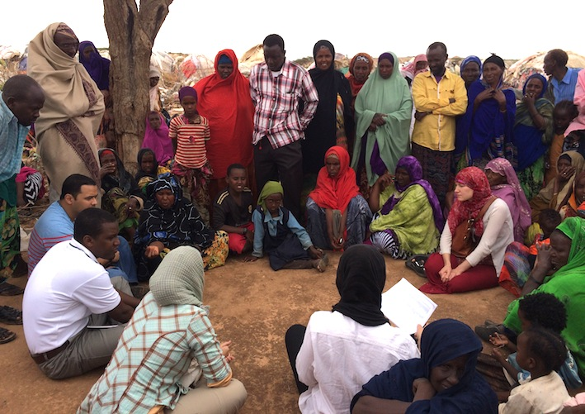
Country examples
Afghanistan: Profiling on IDPs’ protection to inform development of policy on displacement
Somalia: Durable solutions profiling to inform implementation of policy on IDPs
Notes:
Ten minutes:
Give examples of durable solutions profiling exercises
Aim to demonstrate variety and give examples of the points made earlier in the session
Ask participants if they have any other examples to share

Slide 8
The policy-making process
Preparation
Initiation
Validation
Implementation & monitoring
Organisation
Adoption
Drafting & consultation
Notes:
Ten minutes on how and where profiling fits into the policy-making process

Slide 9
Initiation
Profiling process can identify the need for a policy
Initiation

Slide 10
Preparation
Policy scope and shape determine the objectives of the profiling exercise
Profiling to inform the technical processes of policy development such as defining an IDP
Preparation

Slide 11
Drafting and consultation
Profiling process and results to inform the content and priorities of the policy
Drafting and consultation

Slide 12
Implementation and monitoring
Establishing a baseline
Informing an action plan to implement policy through measurable targets and indicators
Follow-up profiling to monitor implementation against targets and indicators
Frequency according to context and evolution of displacement situation
Implement
Monitor
Revise
Plan
Implementation and monitoring

Slide 13
Profiling and policy-making process
Preparation
Initiation
Validation
Implementation & monitoring
Organisation
Adoption
Drafting & consultation
Notes:
Challenges in terms of timing, planning and resourcing

Slide 14
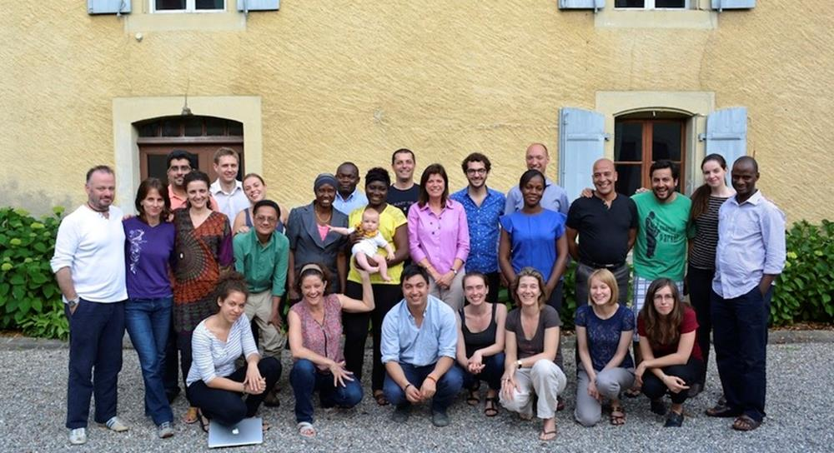
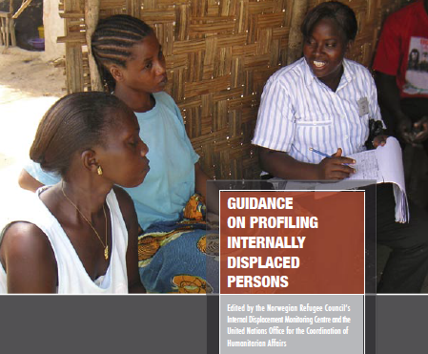
Profiling resources
Joint IDP Profiling Service supports governments, humanitarian and development responders - www.jips.org
Profiling Coordination Training (PCT) trains practitioners on the coordination of profiling in protracted displacement situations
Guidance on profiling IDPs developed by OCHA and IDMC
Notes:
Two minutes:
Make sure participants know where to access profiling support, and give a brief introduction to each source

Slide 15
Profile resources: Online toolkits
Generic tools and guides to browse for assistance, inspiration and adaptation for all stages of a profiling exercise
Online data management system to explore, analyse and report on displacement data collected during profiling exercises
Online database where users can access and share tools and guidelines on profiling and assessment activities

