Slide 1



Drafting

Slide 2
Objectives
To organise the drafting process for a national instrument on internal displacement
To ensure that all stakeholders are properly consulted over the definition of contents
To list all the required elements of a law or policy on internal displacement
To list IDPs’ entitlements during all phases of displacement
Notes:
Discussion of the drafting phase is quite complex because it features at least two dimensions: defining the contents that a qualitative instrument on internal displacement should include, and establishing the procedural requirements to facilitate its adoption.
This objectives of this session are:
To provide structure and organisation to the drafting phase
To maintain effective consultation with all stakeholders over the contents of the draft
To establish the contents and other features of the new instrument
To codify IDPs’ rights and related obligations across all phases of the displacement reponse

Slide 3
Suggested actions
Tentative workplan
Preparation of draft input document
Drafting
Working paper
Inclusive and transparent process
IDPs at the heart of the process
Planning, preparing and holding meetings
Consultations
Review
Glossary of key notions
Outline
Merging components into comprehensive draft
Information, consultation and participation
Publish intentions and regular updates
For each phase…
Notes:
Setting out a tentative work plan for the development of a national instrument
In principle the phases of the drafting process:
spell out tasks and goals
- draft input document
- planning, preparing and holding meetings
- consultations
- review
allocate responsibilities for drafting to:
- the lead agency
- a drafting expert, to provide regular inputs, especially for steering committee meetings
- the drafting committee
- consulting partners
Drafting the national instrument
This should be a structured, step-by-step process that allows all relevant parties to be involved in each step.
- Preparation of a working paper
Preparation of a glossary
Preliminary outline
Annotated timeline, with short explanations of envisaged content
Division of drafting process to allow more in-depth consultation on certain elements
Merger of the different components into a full and comprehensive draft
Validation and adoption
Leading an inclusive and transparent drafting process
Accountability: a bottom-up approach with IDPs at its centre
Inclusiveness: information, consultations and participation
Transparency
Public statement of intent to draft
Regular updates on the process
Clarification of contents and what can be expected with IDPs and others affected by displacement
The prompt and meaningful inclusion of stakeholders
The latter can have a decisive impact on the eventual legitimacy of the new instrument

Slide 4
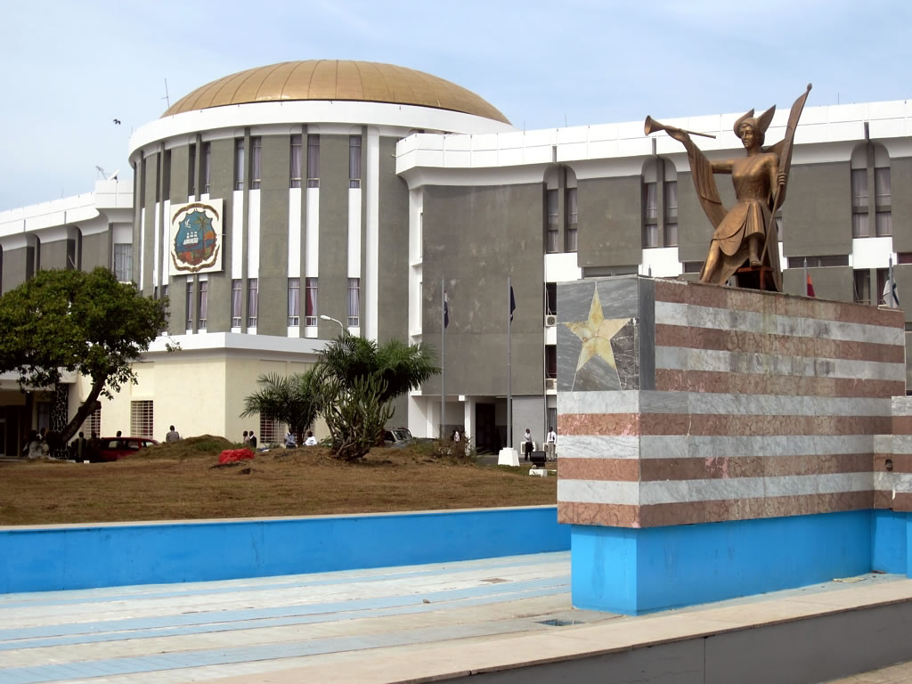
Parliamentarian’s role
Ensure that drafts prepared by staff, departments and civil society contain essential feautures
Identify gaps in the draft legislation and propose amendments
Ensure that parliamentary debate includes discussion of the bill
Present the bill to constituents and civil society and invite comments
Notes:
The core responsibility of parliamentarians is the preparation and review of the draft legislation. They do not, however, tend to engage in the detailed development and drafting of the instrument. Their role consists of four main functions as per the slide.

Slide 5
Who’s who?
Consultation
partners
Steering/drafting committee
Lead
agency
Notes:
This slide is a reminder of Session 4 and of the already defined roles of relevant stakeholders into the drafting process.
This slide is a reminder of session four on stakeholders’ roles and responsibilities in the drafting process.
There are generally four main roles:
The drafting expert
The drafting committee: people with specialised knowledge. Depending on its size, it may be merged with the steering committee
The steering committee: tasked with discussing the texts the drafting committee produces. Made of representatives from various stakeholders
Consultation partners: those not directly involved in the process, including IDPs and others affected by displacement

Slide 6
Use of model laws
Model laws exist to help the domestication of the Kampala Convention and Great Lakes protocol
They are primarily a source of inspiration and guidance for national domestication
Caveat: They are not contextualised, nor country or situation-specific
Notes:
Model laws support government and parliamentary drafters who do not necessarily have the required expertise on internal displacement. Model laws can be very helpful for generalists but they are no match for, and should not replace broad consultations, which are the only way of ensuring a good instrument.
Refer to the Olabisi presentation of the AU’s model law.

Slide 7
General elements
Definitions
  IDP
  People affected by displacement
Basic principles
  National responsibility
  Non-discrimination
  Participation
Identification of responsible authority
Coordination mechanisms
Financial aspects
Notes:
The question of definitions was dealt with in session two.
Basic principles:
The list could be long, but at the very least national responsibility, non-discrimination and IDPs’ participation. Each has been covered earlier in the workshop, but this could be an opportunity to reiterate key messages and provide additional examples.
Identification of a responsible authority:
Refer to the Kampala Convention article 3.2(b) and the Great Lakes Pact protocol on IDPs, article 6.4.c
Questions to be addressed:
Role of the responsible authority?
What type of authority?
- A government department or ministerial portfolio could be created
An authority, committee, steering group or task force could be set up outside existing departments
A national focal point could be situated within an existing department or committee
Uganda, for example, appointed the Department of Disaster Preparedness and Refugees within the prime minister’s office as focal point. The bill currently being debated in the Philippines assigns the role to the country’s human rights commission, an external and autonomous body.
Financial aspects:
- Refer to the Kampala Convention, article 3.2.d
- Reiterate the need to ensure sufficient allocation of resources
- Emphasise that funding arrangements should be adequate, predictable and non-discriminatory
- Emphasise the need to create mechanisms for budgetary oversight

Slide 8
Quiz!
Which Kampala Convention articles refer to the prevention of displacement?
Can you give examples of arbitrary displacement?
Can you find a Kampala Convention article that addresses the specific needs of women and children?
What are the three settlement options for durable solutions?
Can you name the two principles that should underpin the pursuit of durable solutions?
Notes:
Participants take part in groups, with each correct answer earning them a point. The aim is to remind the participants of the main legal provisions and principles to be included in a national instrument.

Slide 9
Essential provisions
Prohibition of arbitrary displacement (Kampala Convention article 4.4)
Prevention of displacement (articles 4.1 and 4.2)
IDPs’ protection and assistance (article nine)
Durable solutions (article 11)
Remedies and access to justice (article 12)
Don’t forget participation, host communities and people with specific needs!
Notes:
This is a reminder that a comprehensive national instrument should cover the three phases of displacement and the rights associated with each one, as discussed in session two.

Slide 10
Refresher: Which rights?
Rights | Kampala Convention
Life, security, protection against violence | 9.1.b. 9.1.c. 9.1.d
Food | 9.2.b
Water and sanitation | 9.2.b
Adequate housing | 9.2.b
Medical assistance and healthcare | 9.2.b 9.2.d
Property, protection against HLP violations | 9.2.i
Freedom of movement | 9.1.a 9.2.f
Recognition before the law
Family life | 9.2.h
Education | 9.2.b
Work and adequate standard of living | 9.2.b
Participation in public affairs | 9.2.l
Humanitarian assistance | 9.3
Notes:
A national instrument on IDPs should address how protection and assistance measures should be taken during displacement. As a minimum it should address the rights set out in the Guiding Principles, which amount to a codification of IDPs’ individual entitlements.
Refer to one or two of the Guiding Principles and illustrate the structure of their provisions:
As a general human rights statement
In terms of their practical relevance for IDPs
A law or policy should:
Make explicit recognition of these rights
Determine that assistance should be measurable according to the four As - available, accessible, acceptable and adaptable
Determine that assistance should be provided with respect for the general humanitarian principles of humanity, impartiality, independence and neutrality, and that is should do no harm

Slide 11
Remedies and access to justice
Physical and mental
harm
What type of remedies?
Who’s responsible?
How does claim process work?
Who can claim?
How does HLP restitution work?
How to decide on compensation?
Displacement
Compensation and satisfaction
Deprivation of land and property
Human rights abuses
Restitution
Compensation
Notes:
The right to effective remedies for harm suffered in the course of, or as a consequence of displacement.
It is possible to distinguish at least two types of harm:
Physical and mental
Deprivation of land and property
Victims should be granted compensation and satisfaction for physical and mental harm
Homes, land and property should be restituted to the legitimate owner, which raises the question of tenure. Can it always be proven? The right to use, which is independent from property rights but may collide with them, should also be considered.
When might it be that property cannot be restituted, and what should happen in such cases? Equitable compensation for the loss should be granted. This is important for the achievement of durable solutions.

Slide 12
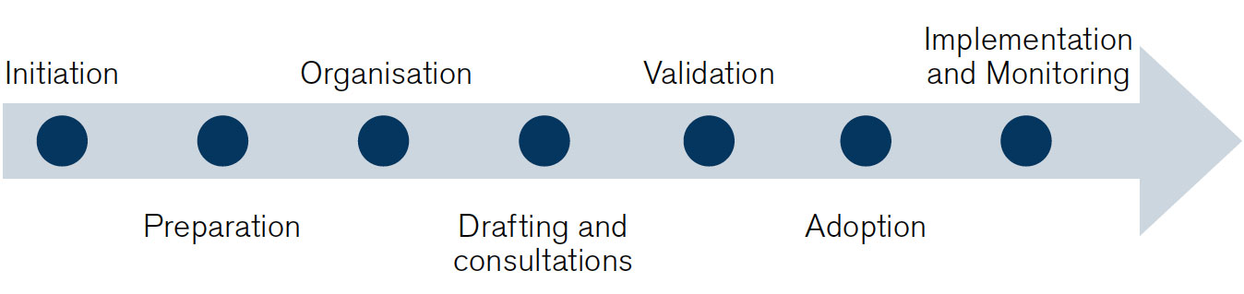
Validation and adoption

Slide 13
Validation and adoption
Validation or not?
Adoption
To consolidate the content of the draft instrument
To obtain support from all parties
Determine who will take part
Key expression of the state’s commitment
Text final and applicable
Final deliberations and last amendments
Adoption according to national procedures
Notes:
Before the government or parliament adopts the draft instrument, it may benefit from validation, which provides another opportunity for changes and amendments.
Validation process may help to:
Increase support for the instrument
Ensure its effective implementation
Consolidate the draft
When approaching this phase, law and policy-makers should address the following questions:
Do we want or need a validation process, and if so, why?
Who should take part in the process?
How are we going to present the contents to different stakeholders and what kind of inputs are we seeking?
To which authority and in which language, length and format do we want to present the final draft for adoption?
When is it opportune to present it?
Example: Validation workshop in Afghanistan, 2013
Advocacy measures to move towards adoption.
Example: Kenya
The executive’s efforts to adopt the policy have been slow. Through PWGID, CSOs have continued to lobby for the process to be sped up, including by proposing questions to the line ministry through parliament in an effort to hold the it accountable.

Slide 14

Conclusions
Drafting a national instrument is a staged process that needs careful planning
The participation of IDPs and others affected by displacement must be ensured
A law or policy should feature a minimum set of contents
Focus should be on prevention, IDPs’ rights and conditions for achieving durable solutions

Slide 15
Checklist
Set out a tentative work plan for the drafting process
Draft the national instrument step-by-step
Lead inclusive and transparent stakeholder consultations
Decide whether to undertake a validation process, and who will take part
Validate the content and finalise the draft
Undertake final deliberations on the draft
Adopt the final text

