Slide 1
5. PROFILING IDP SITUATIONS
Generating an evidence-base for durable solutions
Durable Solutions Workshop
Location, date, year
Joint IDP Profiling Service
Informing Solutions Together

Slide 2
SESSION OVERVIEW
What is Profiling?
Relevance of Profiling for Durable Solutions
The Profiling Process
Country Examples
Profiling Resources
Notes:
2 mins
Review session plan with group

Slide 3
WHAT IS PROFILING?
“Profiling is the collaborative process of identifying internally displaced groups or individuals through data collection, including counting, and analysis, in order to take action to advocate on their behalf, to protect and assist them and, eventually, to help bring about a solution to their displacement”
From the Guidance on IDP Profiling, 2008)
Notes:
2 mins
The formal definition

Slide 4
WHAT IS PROFILING?
Collaborative process to reach consensus and increase impact of data
Data collection and analysis to target response and inform solutions
Context specific and adaptable methodology and approach
Mixed methods approach (quantitative and qualitative) for deeper analysis
Process (not only results) that has tangible impact realized through local ownership
Results include core data (disaggregated population estimates by age, sex and diversity) and thematic analysis such as needs, vulnerabilities and intentions.
“If we don’t come together on data, then we can’t come together on programmes”
OCHA Policy Head, ECOSOC 2015
Notes:
15 mins (including 5 mins discussions up front before bullet points are shown)
Facilitator takes stock of level of participant knowledge on profiling in the room, to enable adaptation of session to cohort.
Has anyone been involved in a profiling exercise?
Can anyone answer the question ‘what is profiling?’
Basic introduction to Profiling in broad terms.

Slide 5
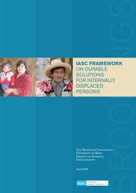
PROFILING for DURABLE SOLUTIONS?
Comprehensive and context specific data
Comparative analysis across different groups (displaced, host, economic migrants etc.)
Helps to identify specific displacement related vulnerabilities
Consensus between humanitarian and development actors
Evidence for strategy development and integrated responses across the different groups
Notes:
10 mins
1. Why is profiling relevant or useful for durable solutions analysis and response?
Emphasis on data/methodology/criteria aspects
2. Why is profiling relevant or useful for durable solutions analysis and response?
Continue explanation of relevance of profiling for durable solutions.
Emphasis on collaborative aspects and consensus building as best type of evidence for joint response and strategy development

Slide 6
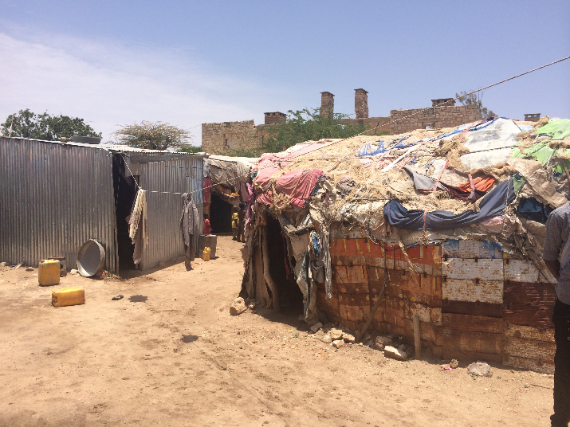
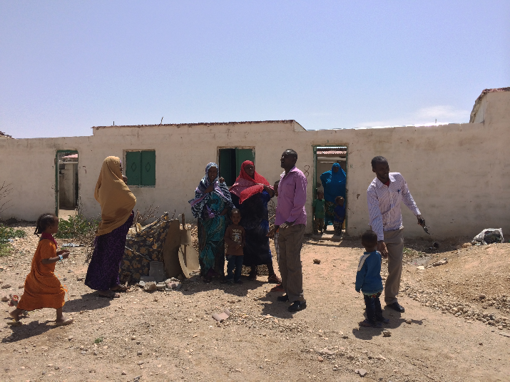
PROFILING for DURABLE SOLUTIONS?
Statehouse IDP settlement, Hargeisa
Ayaha IV settlement, Hargeisa
Notes:
5 mins
Example from Hargeisa Somalia to demonstrate use to profiling to realise IASC criteria analysis.
Moving IDPs from one inner-city settlement to a different location with better housing does not necessarily mean durable solutions are reached. Need fuller anlaysis of broader criteria as outlined in IASC.

Slide 7
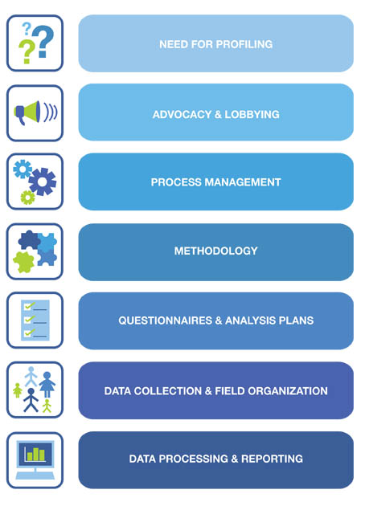
THE PROFILING PROCESS: STEP-BY-STEP
Notes:
40 mins
Facilitator takes participants through profiling process, step-by-step.
Particular attention should be paid to methodology focusing on both quantitative and qualitative elements, and on benefits of sample survey for durable solutions profiling (anonymous data, manageable number of interviews for in-depth data, comparative analysis etc.)
Profiling Process/Snake group work activity
- Add group work instructions
- Main learning outcome is familiarity with profiling process and good sense of resources, expertise and time that should be allocated. The main focus should be on who needs to be involved when, rather than on technicalities.

Slide 8
Why collaborate?
Use resources, skills and expertise
Reduces need for multiple surveys
Ownership of process
Findings of interest / benefit to all:
Government
Multiple organizations / clusters
Platform for common understanding of situation
Planning
Funding
Notes:
5 mins. Short discussion on why we collaborate on profiling exercises and the benefits of this.

Slide 9
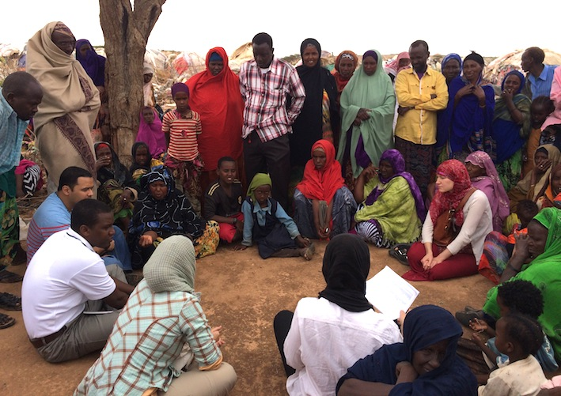
COUNTRY EXAMPLES
Scoping Mission, Somalia 2015

Slide 10
COUNTRY EXAMPLES (cont.)
Cote d’Ivoire: profiling to inform development of durable solutions strategy
Kosovo: profiling to inform implementation of durable solutions strategy
Colombia: profiling to measure progress through the transitional solutions initiative
Somalia: profiling to determine solutions to urban displacement situations
Notes:
20 mins
A few examples of durable solutions profiling exercises.
Aim to demonstrate variety and give examples of point made earlier in the session
Ask participants if they have any other examples to share

Slide 11
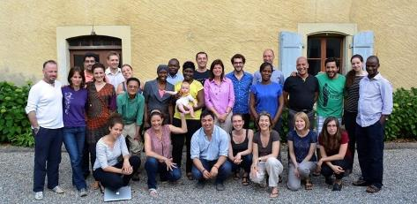
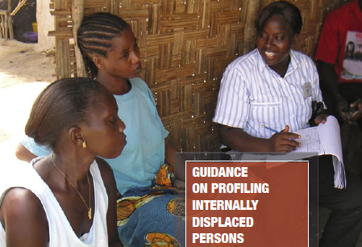
PROFILING RESOURCES
Joint IDP Profiling Service supports Governments, humanitarian and development actors to conduct profiling (www.jips.org)
Profiling Coordination Training (PCT) trains practitioners on how to coordinate profiling in protracted displacement situations
IDP Profiling Guidance developed by UNOCHA and IDMC
Notes:
5 mins
Aim to ensure participants know where to access further profiling resources.
Facilitator should give brief explanation of each

Slide 12
PROFILING RESOURCES: ONLINE TOOLKITS
generic tools and guides to browse for assistance, inspiration and adaptation for all stages of a profiling exercise
online data management system to explore, analyse and report on displacement data collected through profiling exercises
online database where users can access and share tools and guidelines on profiling and assessment activities with guidance
Notes:
5 mins
Aim to ensure participants know where to access further profiling resources.
Facilitator should give brief explanation of each

Slide 13
“Profiling serves many purposes. It is a tool to enhance delivery of humanitarian goods and humanitarian services. It is a tool that helps to enhance protection and prospects for durable solutions. In other words, profiling - well done - is a tool that can facilitate comprehensive and holistic approaches to IDP situations.”
Walter Kaelin, former Special Representative for the Human Rights of IDPs, JIPS conference, 2011
Notes:
2 mins
Quote from previous Special Representative for the Human Rights of IDPs to wrap things up

Slide 14
SESSION SUMMARY
What is Profiling?
Relevance of Profiling for Durable Solutions
The Profiling Process
Country Examples
Profiling Resources
Notes:
2 mins
Facilitator should recap main points of session

