Slide 1



A human rights-based approach to law and policy-making
Notes:
This session reviews the main sources of law applicable to internal displacement. Using a human rights-based approach to address the phenomenon is key to the development of national instruments that aim to ensure IDP’s rights are respected, protected and fulfilled.

Slide 2
Objectives
To illustrate the bodies of international law relevant to IDPs’ protection and assistance
To determine the legal obligations towards IDPs that derive from international instruments
To present a human rights-based approach as the basis for law and policy development
To identify IDPs’ rights during all phases of displacement

Slide 3
International legal standards
International legal
framework for IDPs
IHRL
Human
rights
IHL
IDRL
International criminal law
Notes:
There is no international convention on internal displacement, but international human rights law, international humanitarian law and international disaster law shape approaches to it extensively and should guide any effort to develop a national instrument.

Slide 4
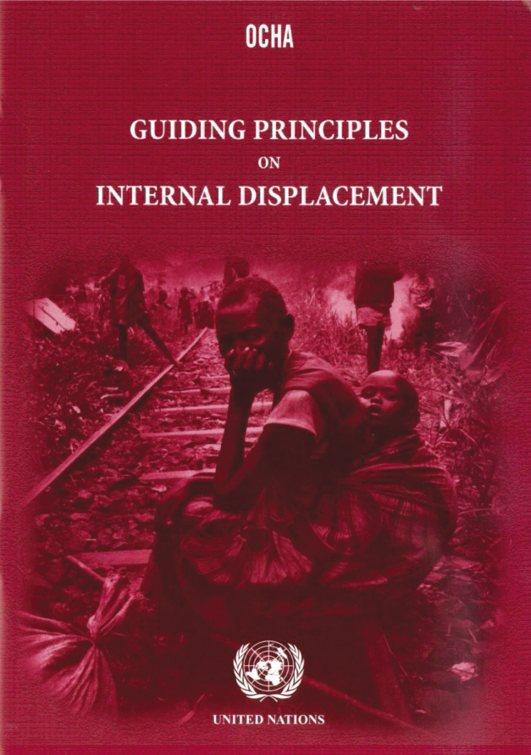
The Guiding Principles
Adopted in 1998 by the UN human rights commission
30 principles restate international law
All phases of displacement covered
Provides a rights-based approach to IDPs’ protection and assistance
Provides guidance to states and others
Identifies relevant IHRL and IHL standards
A practical tool
Notes:
The Guiding Principles detail the guarantees available to IDPs and which aim to prevent arbitrary displacement and to mitigate and resolve it when it does occur. They cover all phases of displacement, including prevention, protection during displacement, and the pursuit of durable solutions. They also set standards for the delivery of humanitarian assistance.
They are grounded in international human rights and humanitarian law, and as such they reflect existing rules and clarify how they apply to internal displacement, instead of creating new obligations. This has facilitated their rapid international acceptance, as reflected in their increasingly widespread inclusion in the domestic frameworks of countries affected by displacement.

Slide 5
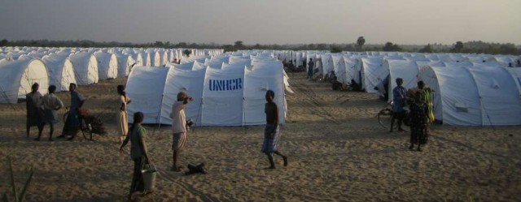
Kampala Convention: a comprehensive instrument
The convention:
Tackles all possible causes of displacement – conflict, violence, disasters and development projects
Addresses all phases of displacement – prevention, protection during it and pursuit of durable solutions
Notes:
The Kampala Convention establishes a legal framework for the prevention of internal displacement, and IDPs’ protection and assistance. It also promotes solidarity, cooperation and durable solutions, and assigns responsibilities and obligations to states and other stakeholders. It entered into force on 6 December 2012.
State parties are legally bound to incorporate their obligations under the convention into domestic law and to adopt policies or strategies on internal displacement at both the national and local level. To this end, they should designate an authority to coordinate efforts to assist and protect IDPs and to ensure the necessary funds are provided to do so.
According to article 3(2), the convention’s principles should also be included in peace negotiations and agreements in order to facilitate durable solutions.
It is a comprehensive document. It covers all possible causes and phases of displacement.

Slide 6
What does the Kampala convention add?
Legally binding
It restates principles and provisions for IDPs’ protection and creates legal obligations for states and others
Specific instrument
It focuses on IDPs and people at risk of displacement
Regional document
It recognises and addresses the specifics and complexity of internal displacement in Africa
Different roles
Addresses the role of armed groups, non-state groups, CSOs, international organisations and private companies

Slide 7
Prohibition of arbitrary displacement
Kampala Convention articles 1.a and 4.4: Right of all people to be protected against arbitrary displacement
Respect
Protect
Fulfil
Refrain
Prohibit
Prevent
Arbitrary displacement
6.2
Examples of prohibited displacement
IHRL
IHL
Legality
Necessity
Legitimate aim
Notes:
To minimise the risk of arbitrary displacement during armed conflict, authorities must ensure full respect for the provisions of international humanitarian law, including those that distinguish between civilians and combatants. Other key obligations include the duty to:
ensure that all involuntary movement of civilians is justified on the grounds of their security or military imperatives
to provide those affected with satisfactory conditions of shelter, hygiene, health, safety and nutrition
to ensure that family members are not separated
to allow those affected to return voluntarily to their homes or places of habitual residence as soon as the grounds for their displacement have ended

Slide 8
Prevention
Article 4.2: State responsibility to prevent and avoid conditions leading to displacement
Conflict:
Protection of minority rights, rule of law, participation, adequate standard of living
Prevention of IHL violations that trigger displacement
Dialogue with all parties, outreach to security forces, training
Fight against impunity
Criminalisation of arbitrary displacement
Disasters:
“There is no such thing as a ‘natural’ disaster, only natural hazards.” UN office for DRR
Disaster management, mitigation and preparedness
Early warning systems
Model act on disaster relief and initial recovery assistance, 2013
Notes:
A national instrument on internal displacement should include a provision that gives national authorities full responsibility to:
- protect against displacement and avoid conditions that lead to it
- to undertake displacement, when unavoidable, according to the criteria set out in guiding principle seven
The obligation to prevent displacement and avoid conditions that may lead to it is complemented by the duty to undertake displacement only in extreme circumstances and by putting a series of arrangements in place to ensure the fairness of the process.
What does this mean in practice in terms of displacement caused by disasters?
Refer to IFRC’s model act on disaster relief and assistance. It is intended to serve as a reference tool and example for law and policy-makers as they draft legislation on managing external aid according to their national circumstances and touching on all aspects of disaster relief and assistance. As such, it may be particularly useful to MPs who are involved in developing a national instrument on internal displacement.
Displacement can often be prevented or mitigated through the use of early warning systems, which form part of disaster response frameworks. The UN office on disaster risk reduction (UNISDR) has identified a number of measures that can help to manage disasters.

Slide 9
IDPs’ protection: Articles 5.7 and 9
A. Civil and political rights related to people’s lives, safety, physical wellbeing and family unity. | B. Economic, social and cultural rights related to food, basic shelter, health and primary education
D. Civil and political rights related to personal documentation, and freedom of movement, expression, opinion, religion and voting | C. Economic, social and cultural rights related to housing, land and property (HLP), livelihoods, and secondary and higher education
Source: UN secretary general’s representative on IDPs’ human rights
Notes:
Internal displacement involves many challenges to IDPs’ human rights, including the loss of their homes and livelihoods, the disruption of their children’s education, the separation of their families, the break-up of their social networks, the loss or destruction of their personal documents and exposure to violence.
IHRL covers civil and political rights, such as those to life, family unity and documentation; and economic, social and cultural rights, such as those to food, water, adequate housing, education and health services. The catalogue of human rights contains individual entitlements and lays out states’ obligations to respect, protect and fulfill them. Human rights protection is relevant before, during and after displacement, and human rights law is relevant to IDPs regardless of the cause of their displacement.
The incorporation of IHRL into national laws and policies on internal displacement helps to ensure that the measures taken to respond to IDPs’ needs meet such standards. It provides a clear benchmark for state action, and can be used to identify and clarify the responsibilities of government entities.

Slide 10
Durable solutions: Articles 11 and 12 and the IASC framework
Achieved when “IDPs no longer have specific needs linked to their displacement and can enjoy their human rights without discrimination on account of their displacement”.
Establish IDPs’ right to a free and informed choice between:
    Sustainable reintegration in place of origin
    Sustainable local integration
    Sustainable integration in another part of the country
Affirm the state’s responsibility to establish the conditions for IDPs to achieve durable solutions
Notes:
A law or policy on internal displacement should also cover the general principles that govern the pursuit of durable solutions.
IDPs’ needs and vulnerabilities continue after the circumstances that led to their displacement have ended, and legislation needs to provide for their ongoing protection and assistance.
IDPs have the right to choose between the three settlement options that can lead to durable solutions, and it is national authorities’ primary responsibility to establish the that enable them to do so and bring their displacement to a sustainable end.

Slide 11
Criteria for durable solutions
Long-term safety and security
Adequate standard of living
Access to livelihoods and employment
Access to remedies and justice
Accessible mechanism for restoration of HLP
Personal and other documentation
Family reunification
Participation in public affairs
Kenya’s 2012 act on IDPs incorporates the eight criteria and adds the « full restoration and enjoyment of freedom of movement »
Notes:
The IASC framework on durable solutions establishes eight criteria by which to measure progress towards their achievement:
Long-term safety and security: IDPs are physically protected and the causes of their displacement have been addressed
Adequate standard of living: They have access to the basic necessities of life
Access to livelihoods and employment: They have access to work, income and social services
Housing, land and property: They have access to effective mechanisms to restore HLP or receive compensation
Personal and other documentation: They have access to personal and other documentation and to mechanisms to replace documents lost during their flight
Family reunification: They have been reunited with family members from whom they became separated during displacement
Participation in public affairs: They have access to public sector jobs, and are able to vote and run for public office

Slide 12

Regional standards
African Charter on Human and People’s Rights (ACHPR) – ACHPR protocol on women’s rights
African Charter on the Rights and Welfare of the Child
Pact on Security, Stability and Development in the Great Lakes Region (Great Lakes Pact)
Protocol on IDPs’ protection and assistance
Protocol on returnees’ property rights
Notes:
The 2006 Great Lakes Pact and its ten protocols and action plans of action seek to create lasting conditions for security, stability, sustainable development and reconstruction in the region.
The protocol on IDPs’ protection and assistance establishes a regional framework that ensures the adoption and implementation of the Guiding Principles, and aims to improve the legal protection of IDPs’ physical safety and material needs. The protocol on returnees’ property rights is also a key reference point because it addresses land and property issues as part of the process of achieving durable solutions.
The pact is legally binding upon member states of the International Conference on the Great Lakes Region. They are obliged to develop national instruments on internal displacement in line with both it and its protocols, and to domesticate the Guiding Principles.

Slide 13

Ratification and domestication
Article 3.2.a : “States Parties shall: Incorporate their obligations under this Convention into domestic law by enacting or amending relevant legislation on the protection of, and assistance to, internally displaced persons in conformity with their obligations under international law”.
Monist v dualist systems
Two steps
Internal procedure: before the state assumes its international obligations
External procedure: consent to be bound by the other contracting parties
Notes:
Possible advocacy for ratification:
- Raise awareness of relevant standards
- Lobby for the signing of relevant treaties
- Monitor parliamentary steps towards ratification
- Following up with foreign ministry on the depositing of the ratified instruments with the AU

Slide 14
Conclusions
International legal standards are benchmarks for states’ action.
IHRL, IHL, IDRL and ICL are relevant to IDPs’ protection and assistance.
Adhering to international standards is a general state responsibility.
A human rights-based approach should guide policy-making processes.

