Slide 1
From shared understanding to shared vision: supporting local actors to identify and respond to the needs of IDPs and vulnerable host communities in Bangui, CAR Louise Thaller, IMPACT Initiatives
Geneva, 1st October 2019
Notes:
Bêkou, Ville de Bangui, ACTED

Slide 2
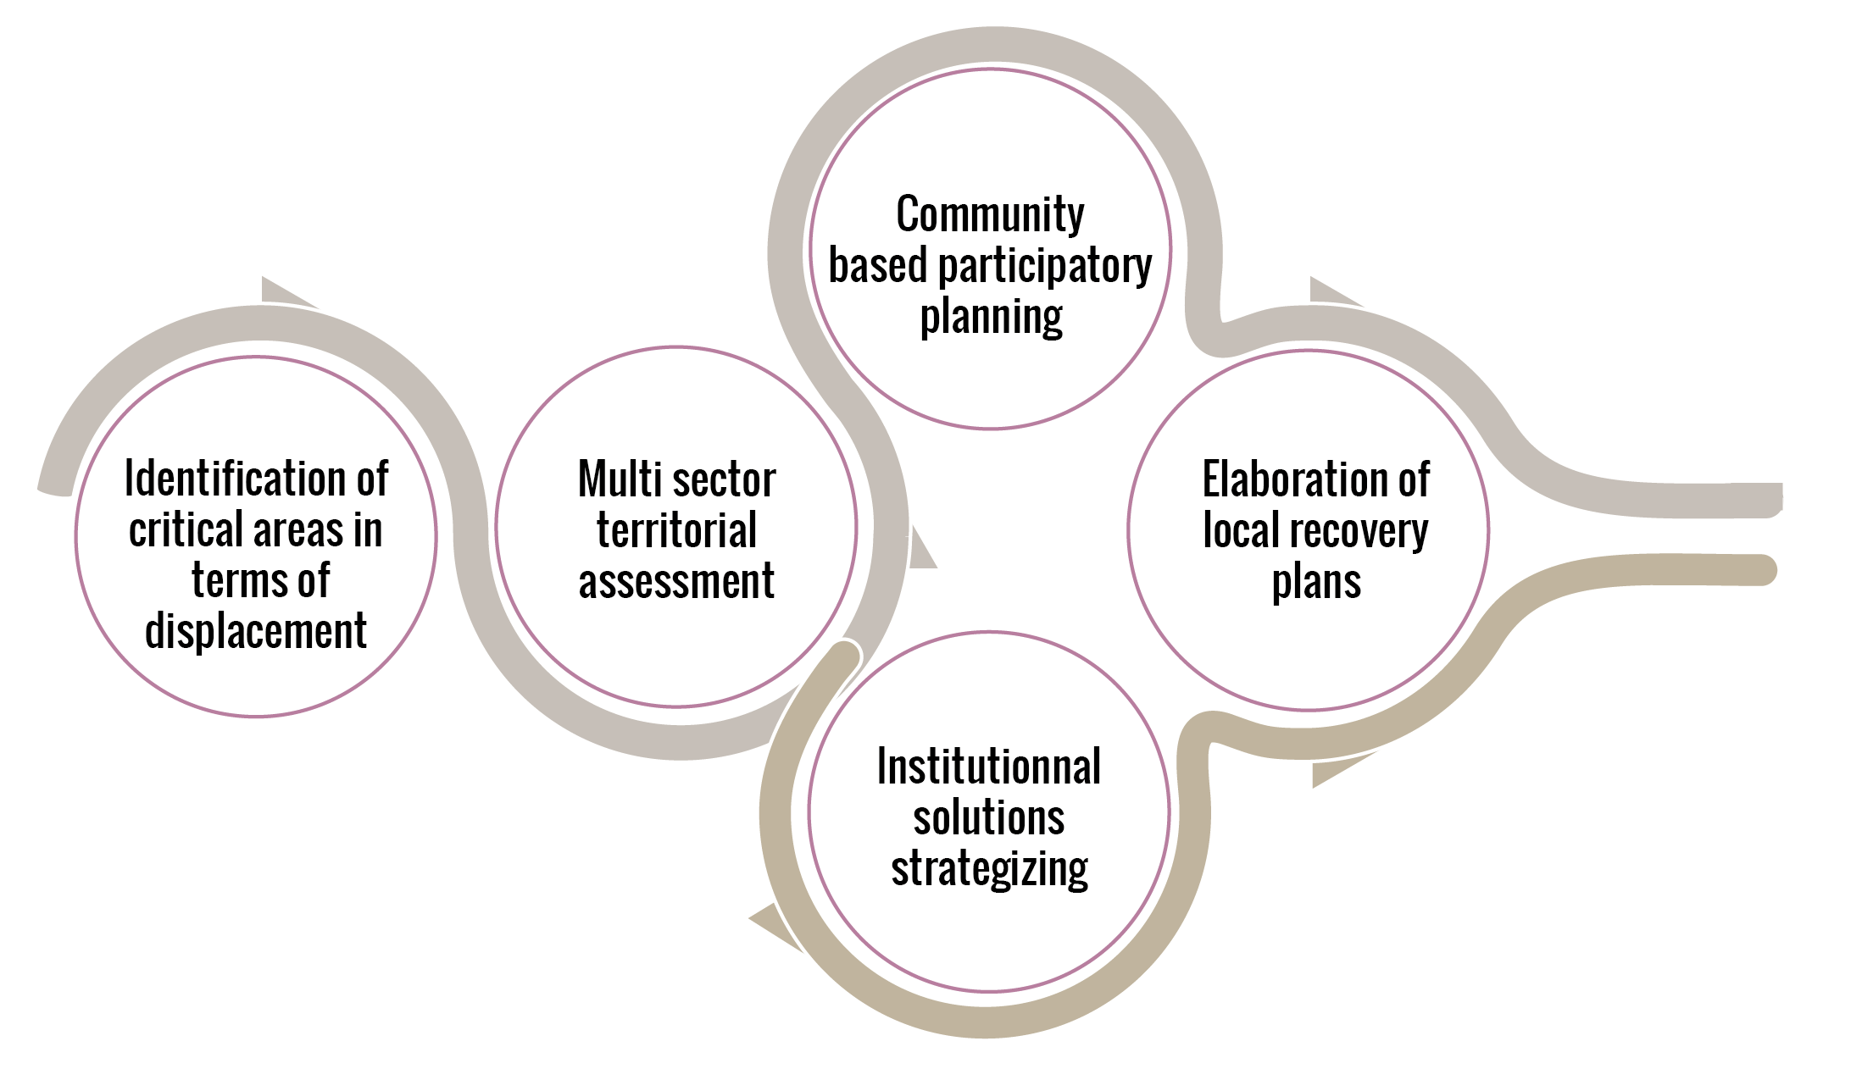
An evidence and area-based planning approach
Applicable to contexts of protracted urban displacement contexts, slow onset, post conflict settings
Advocay
Training
Coordination
Notes:
Local planning instrument tailored to urban post-crisis and recovery contexts.
Piloted across a varied scope of situations.
Especially relevant in protracted urban contexts and support local authorities in mainstreaming solutions to urban displacement in their local development planning strategies
In depth analysis of the needs in territories affected by displacement.

Slide 3
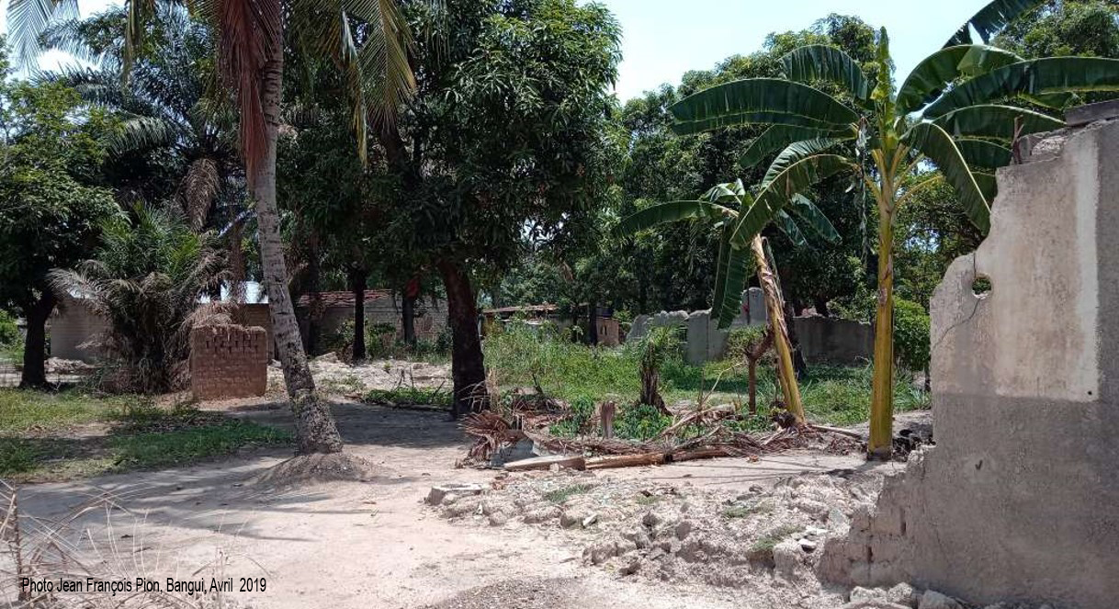
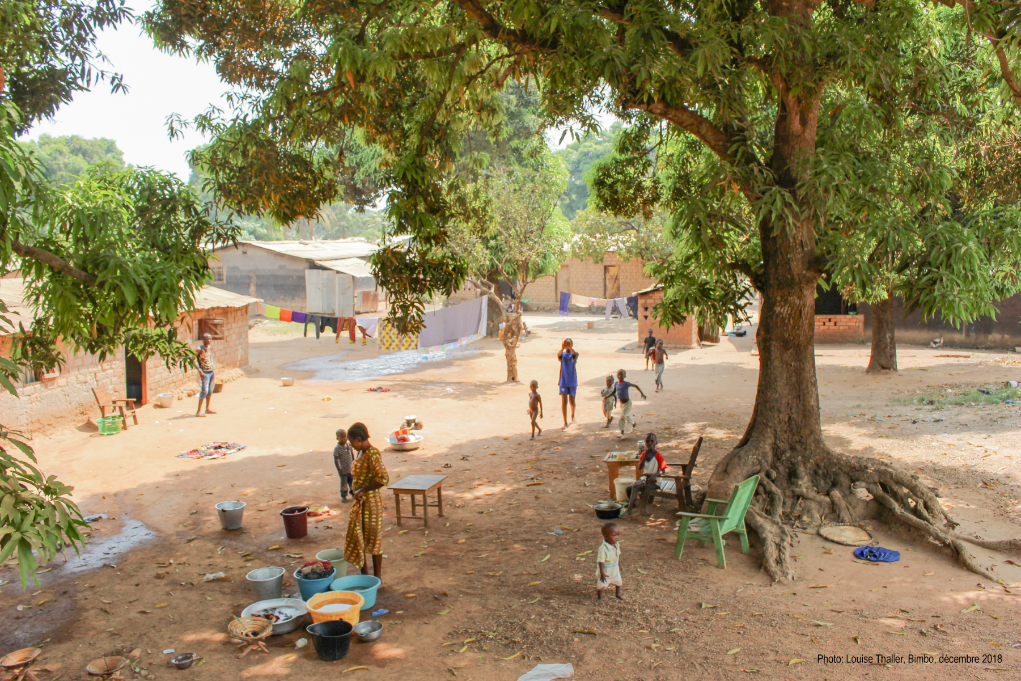
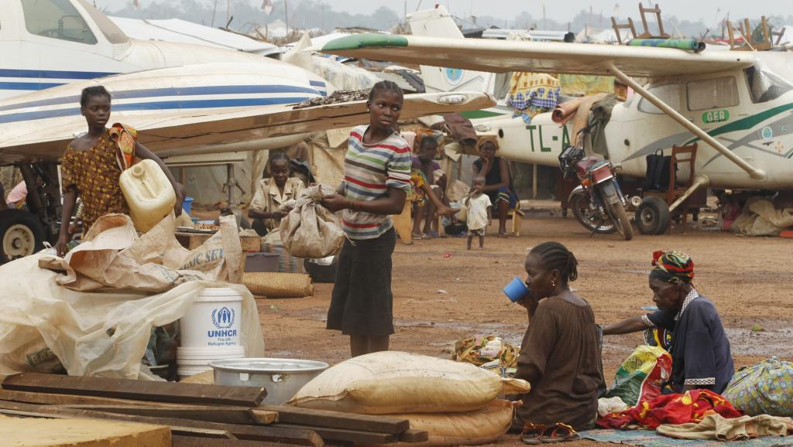
Protracted urban displacement in Bangui
Need to mainstream displacement in urban planning strategies
In 2014, 100,000 forced to displacement in 32 camps within the city of Bangui
By 2017, the shut down of camps initiated returns but maintained about 45,000 in a protracted displacement situation
The urban areas most affected by displacement are also the most impoverished and require development investments
Durable solutions rank high on the agenda but remain an issue of humanitarian focus
Notes:
Damaged / destroyed thousands of homes
45,000 displaced scattered across the city’s precarious neighborhoods
While a majority of the neighborhoods which had been destroyed are yet to be rebuilt

Slide 4
From multisector area based assessments
Start with building a shared understanding of the dynamics which continue to trigger displacement
Some findings*
Between 30% and 42% of households are displaced, and the harmful consequences of displacement are felt by 70% of households
Between 70% and 86% of displaced households favor local integration to returns
Generalized and growing mistrust against local authorities, yet high expectations that the State, before external partners, will address their challenges
Prominent lack of trust in security forces in PK5, while security threats are a secondary challenge in Bimbo
* From the May 2019 area based assessments

Slide 5
To consensual and feasible recovery planning
To support local actors in making informed and efficient decisions intersecting displacement response and urban recovery
Short, medium and long term solutions compiled in local recovery plans
Identifies responsible agencies for each intervention
Mainstreams displacement in local planning strategies
Targets both displaced and host communities + public services
Interpret the findings and prioritize needs against their own perception of living conditions and aspirations
Community
based planning
Elaborate concrete responses to the needs, in line with sectoral priorities, municipal strategies and national legal frameworks
Institutional planning

Slide 6
One step further : supporting local actors to advocate and source out for implementation
The recovery plans are out…. how do we ensure they are implemented?
Training programs for local authorities and civil society actors to jointly advocate vis à vis the central government and external partners for funding
Building area-based, as opposed to sector-based coordination platforms under the leadership of municipal actors to build collaborations and monitor implementation

Slide 7
Challenges and opportunities for scale ups
Challenges
Opportunities
Such recovery plans should be integrated into decentralized planning strategies to avoid remaining stand-alone products
Humanitarian and development funding is rarely channeled through municipalities
Calls out for more flexible funding streams to guarantee some of the key recommendations will be implemented
Cities and local authorities’ role in dealing with urban displacement is increasingly recognized
Grand Bargain and New Way of working are influencing the aid landscape

